Slide 1
Energy Needs of Growing Economy
Where, GDP - Gross domestic product

Slide 2
Energy Needs of Growing Economy

Slide 3
Energy Intensity
Energy intensity on PPP:

Slide 4
Energy Intensity

Slide 5
Long term energy scenario for India

Slide 6
Long term energy scenario for India

Slide 7
Long term energy scenario for India
LNG – Liquified Natural Gas

Slide 8
Long term energy scenario for India

Slide 9
Energy Pricing (in India)

Slide 10
Energy Pricing (in India)

Slide 11
Energy Security

Slide 12
Energy Security

Slide 13
Energy Security

Slide 14
Energy Security

Slide 15
Energy Security

Slide 16
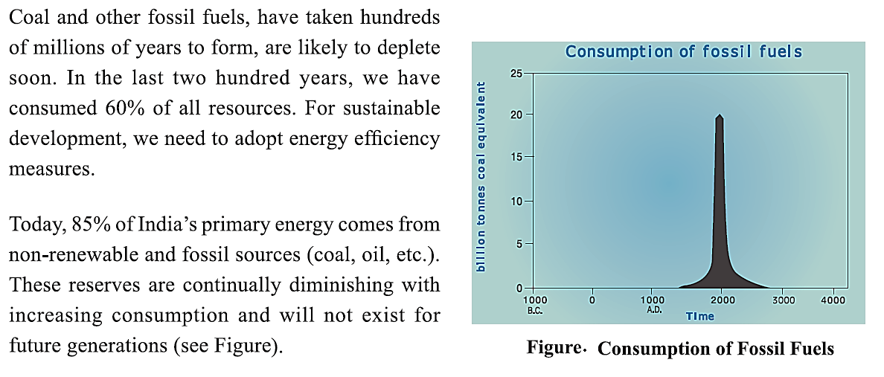
Energy Conservation and its importance

Slide 17
Energy Conservation and its importance
Energy Conservation and Energy efficiency:

Slide 18
Energy Conservation and its importance

Slide 19
Energy Conservation and its importance
GHG – Green-House Gas

Slide 20
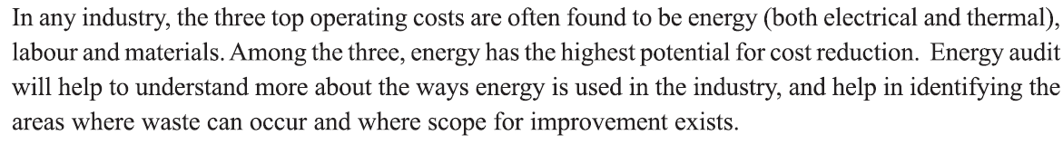
Energy Audit
Need for Energy audit:

Slide 21
Energy Audit
Types of Energy audit:

Slide 22
Energy Audit

Slide 23
Energy Audit

Slide 24
Energy Audit

Slide 25
Energy Audit

Slide 26
Energy Audit

Slide 27
Energy Audit

